Slide 1
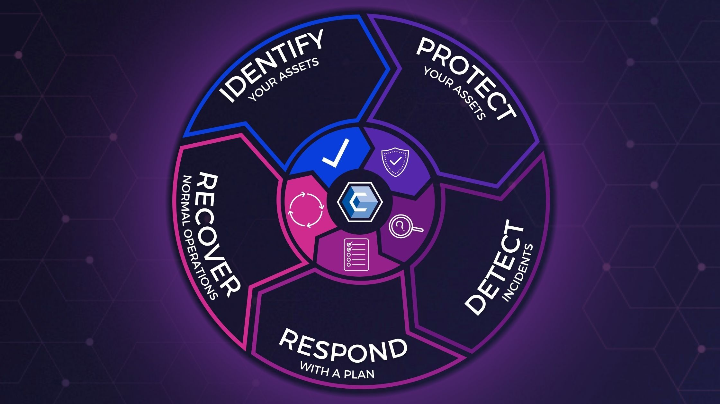
IMPROVING CAN BUS SECURITY AGAINST ADVERSARIAL ATTACKS
ARIHANT JAMMAR
SURYAKANT SHUKLA

Slide 2
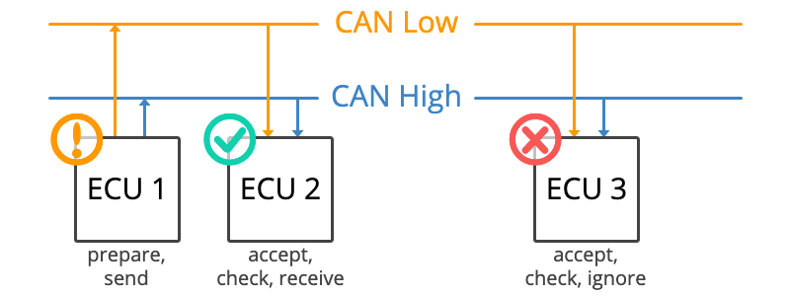
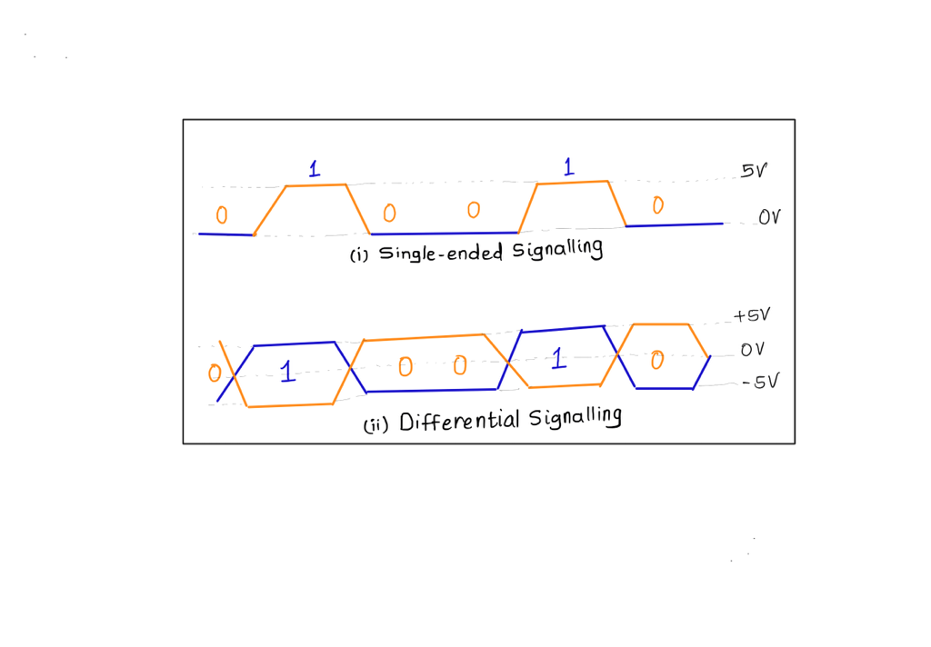
CAN can stands for Controller Area Network. It is a widely used serial communication protocol which is utilized in Automotive and Industrial Applications to avoid the wiring harness required to connect these ECUs. It was developed by Robert Bosch in 1980s. CAN uses multi-master serial communication system. It allows devices to communicate with each other using a shared communication bus. It uses differential signalling to transmit data , which means it is less susceptible to noise and interference. It is an low-cost communication system with minimal wiring and simple components which can provide data rates up to 1Mbps (using CAN FD it can reach up to 8Mbps).
Fig. 1 CAN Bus Structure
Fig.2 Single ended vs Differential Signaling
Notes:
Multi master means multiple nodes are capable of inititating comms and transmit data on the CAN bus

Slide 3
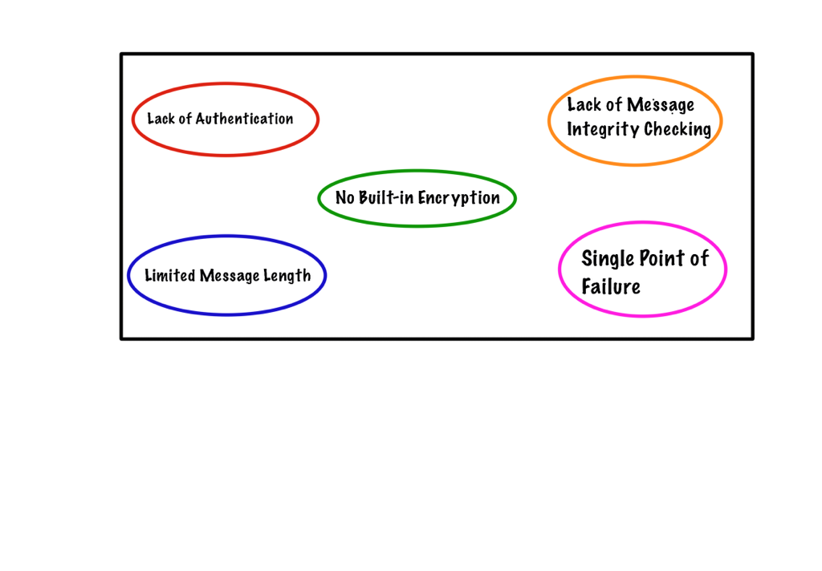
SECURITY LIMITATIONS OF CAN BUS
Fig. 3 Security Vulnerabilities

Slide 4
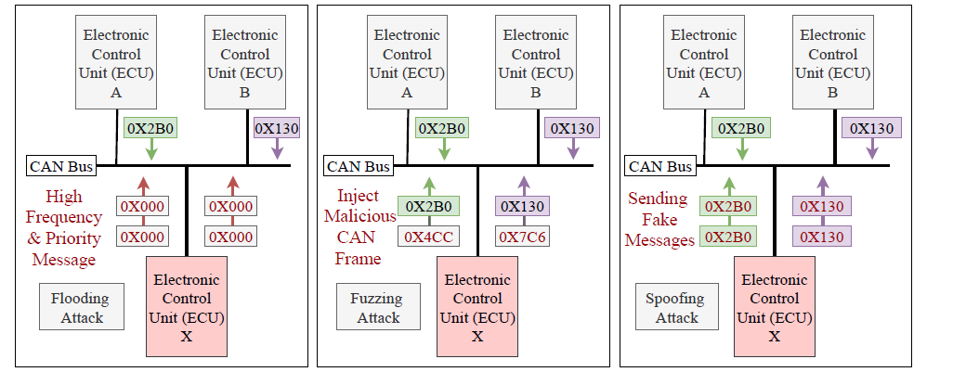
Exploitation of security vulnerabilities
If an attacker somehow gets access to CAN Bus the attacker can monitor the CAN Bus messages and can also gain information about the network topology used in the system.
Using this knowledge the attack can launch several attacks such as replay attack, spoofing attack, DoS attack, injection attack etc.
In CAN Bus communication messages are sent and received by ECU (CAN) Nodes, and arbitration ID is used to assign priority to these messages to avoid conflict and collisions.
Fig. 4 Flooding Attack, Fuzzing Attack, Spoofing Attack on CAN Bus
Notes:
If an eavesdropper gets access to ECU he can monitor CAN bus messages such as by hijacking a malicious node through internet, it can obtain the arbitration ID sequences that are communicated on the CAN bus, and using these the attacker can produce it’s own CAN Bus message frame to perform some of the attacks such as as replay attack, spoofing attack, DoS attack, injection attack etc

Slide 5
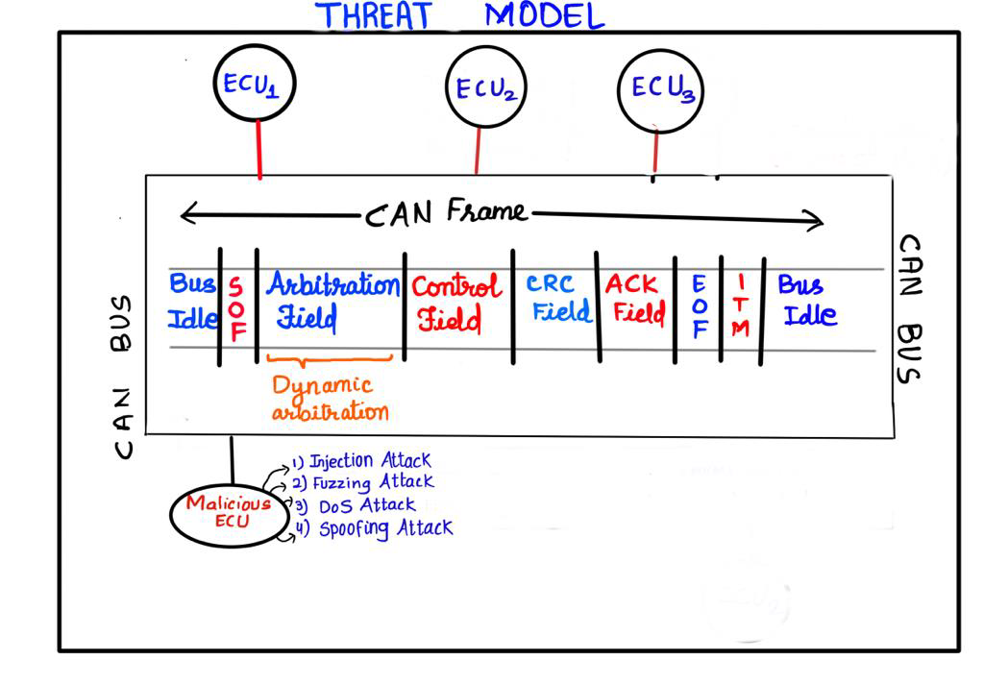
Fig. 5 Threat Model of CAN Bus System
If an eavesdropper gets access to CAN bus messages such as by hijacking a malicious node through internet, it can obtain the arbitration ID sequences that are communicated on the CAN bus, and using these the attacker can produce it’s own CAN Bus message frame to perform some of the attacks mentioned before.

Slide 6
PREVENTION OF ADVERSARIAL ATTACKS
The adversary can make an intelligent guess about the arbitration IDs that can serve its purpose of attack; it is necessary to make an arbitration system that makes it difficult for the adversary to guess the arbitration ID which can be used in upcoming message frames.
To overcome the above attack, we have implemented dynamic arbitration to prevent spoofing or impersonation attacks.
An arbitration ID window is defined and accumulated clock offset (X) is computed for each arbitration ID using Timestamps of the CAN messages. The logic used is shown below:
The highest priority message has a lowest arbitration number and vice-versa.
Notes:
For each reassigned ID, we consider having a value window (WID). Each WID uses three arbitration IDs, including its own and two neighboring IDs.
Here, the reassigned ID’s value will be within the range of the previous and the next arbitration ID.
If IDi is the first arbitration ID in the ordered list, then IDi-1 will be “0.”
If IDi is the lastarbitration ID in the ordered list, IDi + 1 will be 2^11–1, which is considered the highest arbitration ID a standard CAN arbitration field can hold.
the ordering of arbitration IDs is considered an important feature.
The primary reason is that the arbitration IDs are used to determine which message will go through the CAN when more than one CAN message is simultaneously broadcast through the CAN bus.
the new assigned ID must keep the original order of the CAN arbitration ID.
it is possible to bias the ID in a positive (IDi + 1) direction or a negative (IDi-1) direction
Here, we biased the new ID (IDi new) considering the maximum difference (δ) as: Then we shift IDi using the equation where X is the scaled accumulated offset of the arbitration ID time intervals

Slide 7
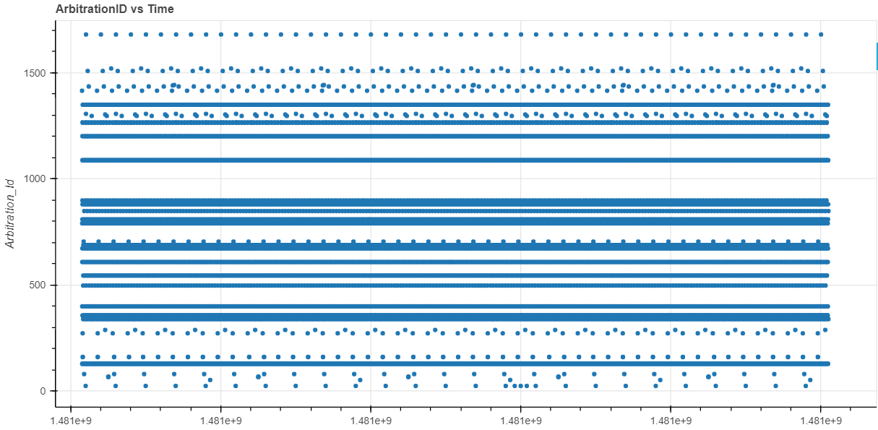
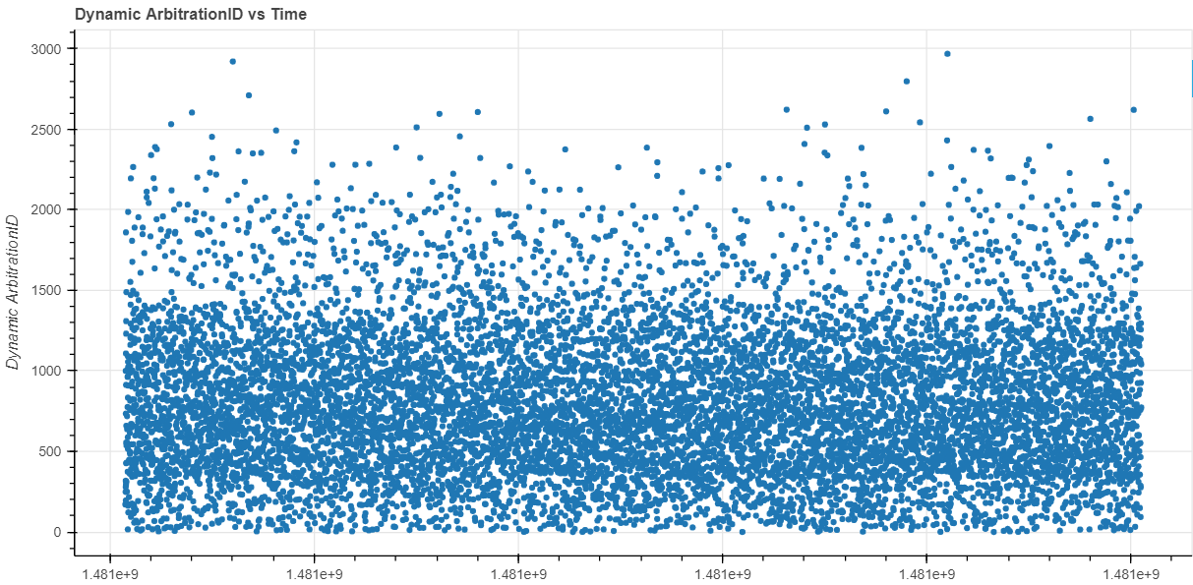
Arbitration ID sequence vs Time
Dynamic Arbitration ID sequence vs Time
Fig. 6
Fig. 7
Here, We can notice that in dynamic arbitration it will be very difficult for any adversary to guess the arbitration ID or generate any impersonated CAN frames.

Slide 8
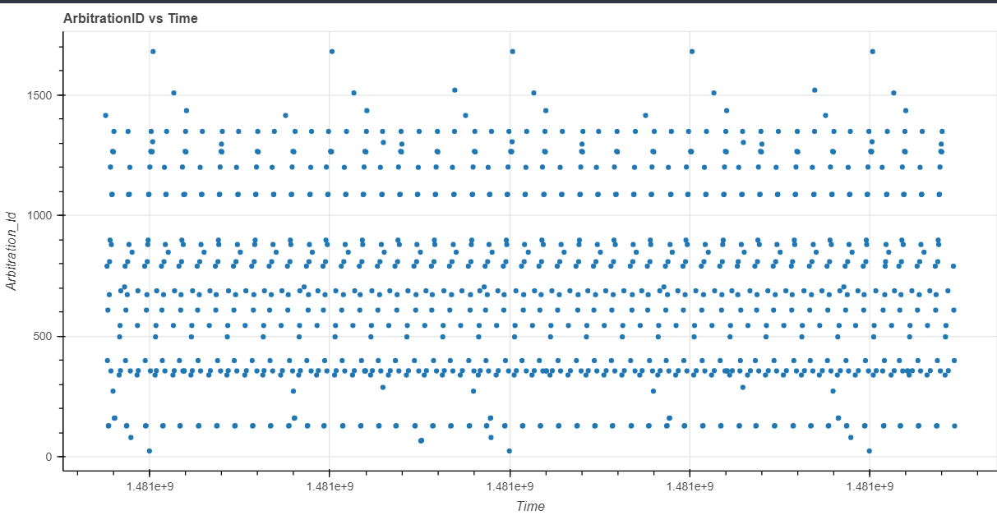
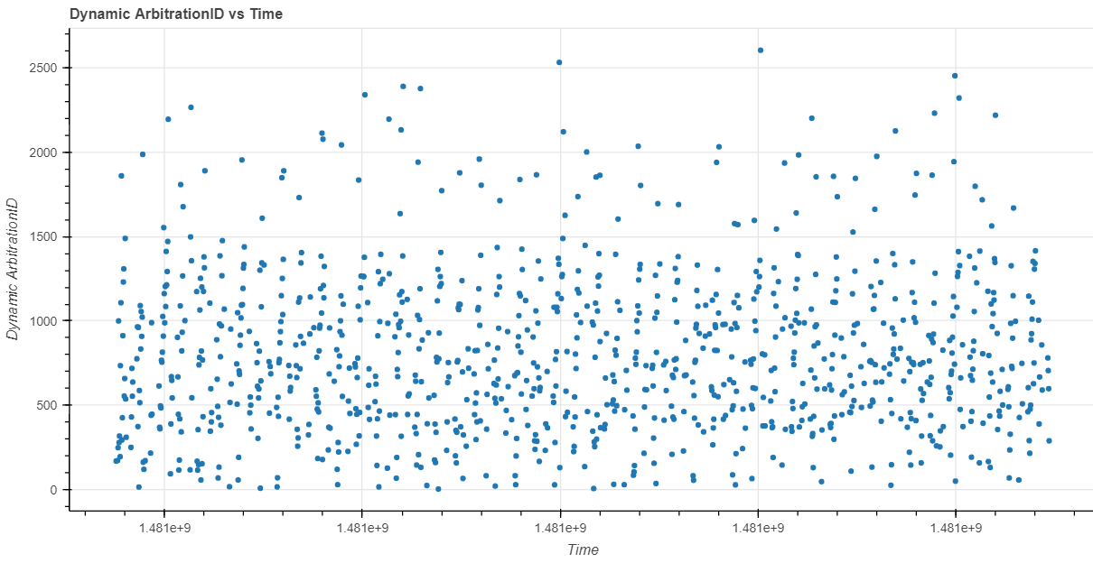
Arbitration ID sequence vs Time
Dynamic Arbitration ID sequence vs Time
Fig. 8
Fig. 9
These plots have been generated for a small batch of data and it helps to visualize the retention of priority of CAN Message Frames
Notes:
Assuming at max 5 message frames in a time series being transmitted over CAN Bus, the arbitration IDs of these frames follow the priority order as in the normal scenario.

Slide 9
INTRUSION DETECTION SYSTEM An IDS system has been used to provide protection against any abnormal or adversarial situations. This IDS system has been developed using Convolutional Neural Networks (CNN) because CNN has shown promising results in image classification, image detection and image segmentation problems. So to take advantage of the CNN capability, it is trained using recurrence plot of arbitration IDs. A recurrence plot is a way of visualizing patterns in data over time. It also preserves the temporal dependency present in the data. It is used in descriptive statistics and chaos theory. Temporal dependency is used to capture correlations and changes in the distribution of the underlying data generating process which helps to improve predictions and reduce noise in the data We have used the pyts library and RecurrencePlot class to generate the arbitration ID plots.
Notes:
Uptil now we have tried to prevent any adversarial attacks ,but using IDS we can detect attacks and in this we make sure that if there is an attack IDS detects and reports it.

Slide 10
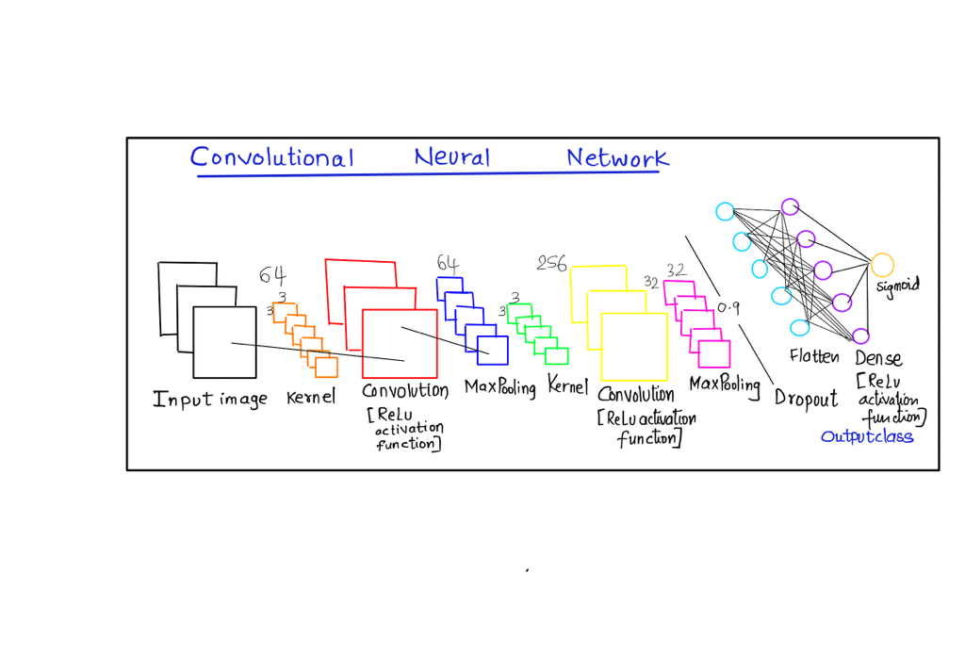
architecture OF PROPOSED CNN Model
Fig. 9 CNN Model
Input image is convolved using a 3x3 kernel and then it is reduced in dimension using MaxPool of strides=2 and then we have used dropout layer to avoid overfitting and at the end the flattening layer converts it into a single dimension layer which is fully connected and ReLu activation function is used.
Notes:
Convolutional layers of CNNs have sparse interactions, which is accomplished by smaller kernels than the input. On top of that, CNNs, unlike ANNs, are capable of sharing parameters that make CNNs faster in operations. This property of parameter sharing causes the layers to have an equivariance property to translation; when the input changes, the output changes in the same way. Training of the CNN, is done using backpropagation;

Slide 11
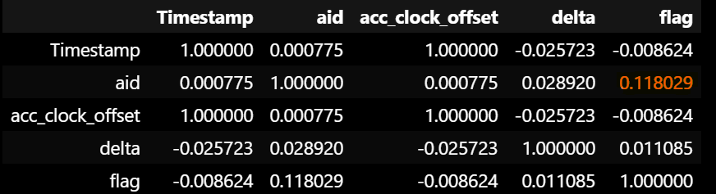
CORRELATION COEFFICIENTS
A correlation coefficient is a statistical measure that describes the strength and direction of the relationship between two variables.
The magnitude of the correlation coefficient indicates the strength of the relationship between the two variables.
Here the flag feature i.e., either attack or benign labels and arbitration Id have the highest correlation coefficient, which implies arbitration ID is the most suitable parameter for training and testing our CNN model.
Fig. 10 Correlation Coefficients
Notes:
We have considered arbitration ID as our input parameter that has to be trained by the algorithm,

Slide 12
WORKFLOW
The CAN frames from the files Attack Free Dataset, Impersonation Attack, Fuzzy Attack, DoS Attack datasets are taken and are reconstructed using the regular expression:
Timestamp:\s+(\d+\.\d+)\s+ID:\s+([\da-f]{4})\s+\d+\s+DLC:\s+\d+(\s+[\da-f]{2})*", r"\1@\2", lines).strip("\n").split("@")
The attack free frames are labelled as 0 which represents benign scenario and the remaining attack frames are labelled as 1 which represents attack scenarios for binary classification.
The reconstructed data is normalized and it is utilised in constructing recurrence plots which is reshaped to (128*128). So we have converted the attack detection problem to image classification problem

Slide 13
These recurrence plots are then split into training, validation and testing data in the ratio 18:2:5
CNN Model is built using the Convolution, Pooling, Dense Layers from the Keras library, Kernel size of (3 * 3) is used to perform convolution.
Keras-Tuner library is used to perform Hyperparameter optimisation of the activation functions and the units used in the Dense Layers.
Using the Optimised Model the Training and Validation Data is fed to this Neural Network on 80 epochs and it trains the model iteratively.
After the model is trained , testing data is used to check the accuracy of our model in detecting attack and benign scenarios. Then we compute the F1-Score, Precision, Recall, ROC-Score, TPR, FPR and plot a ROC_Curve.
Notes:
Hyperparameter optimization is the process of searching for an optimal set of hyperparameters in CNNs , that would result in better performance. algorithms have no way of learning these variables.

Slide 14
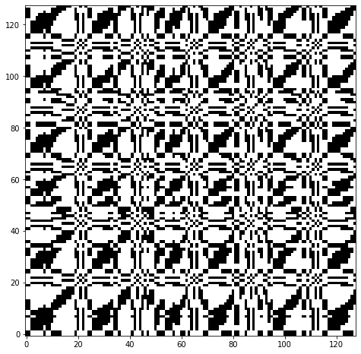
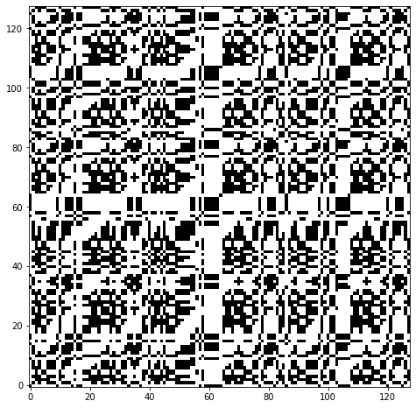
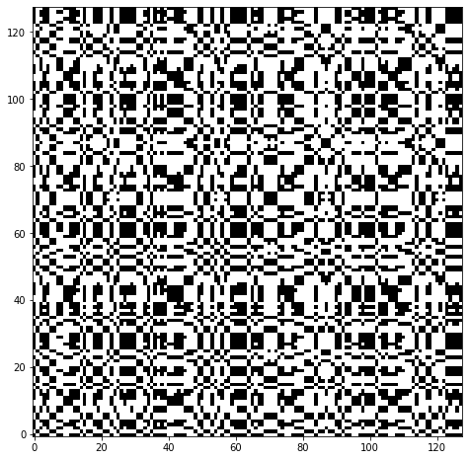
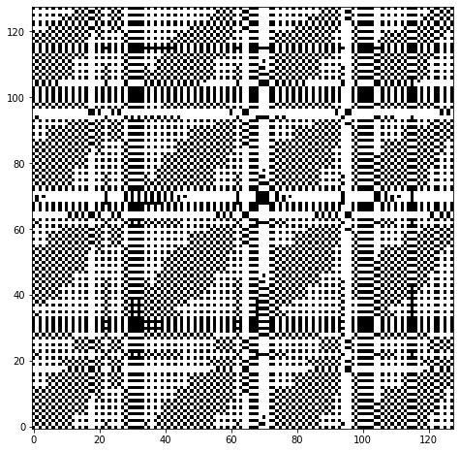
Recurrence plots
Fig. 11 Recurrence Plot of Attack Free Data
Fig. 12 Recurrence Plot of Impersonation Attack Data
Fig. 13 Recurrence Plot of Fuzzing Attack Data
Fig. 14 Recurrence Plot of DoS Attack Data
Notes:
First we, collect 128 arbitration IDs of packets arriving in the CAN bus. The arbitration IDs are then encoded to a number be-tween 0and N, and the encoded sequence of arbitration IDs is converted to CNN’s input image using RPs. The training image is subsequently generated out of the square matrix in the RPs with a dimension of 128 ×128.
1.

Slide 15
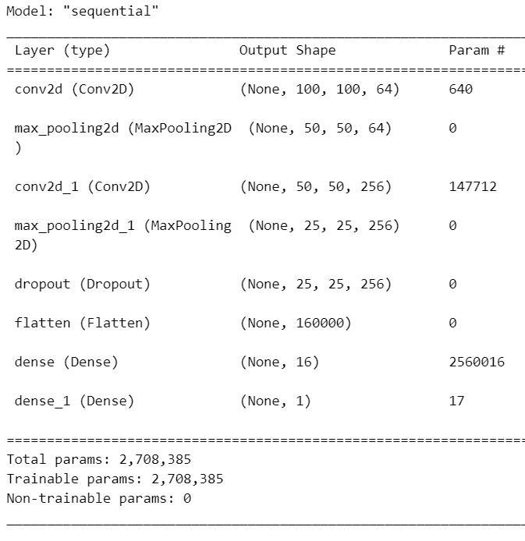
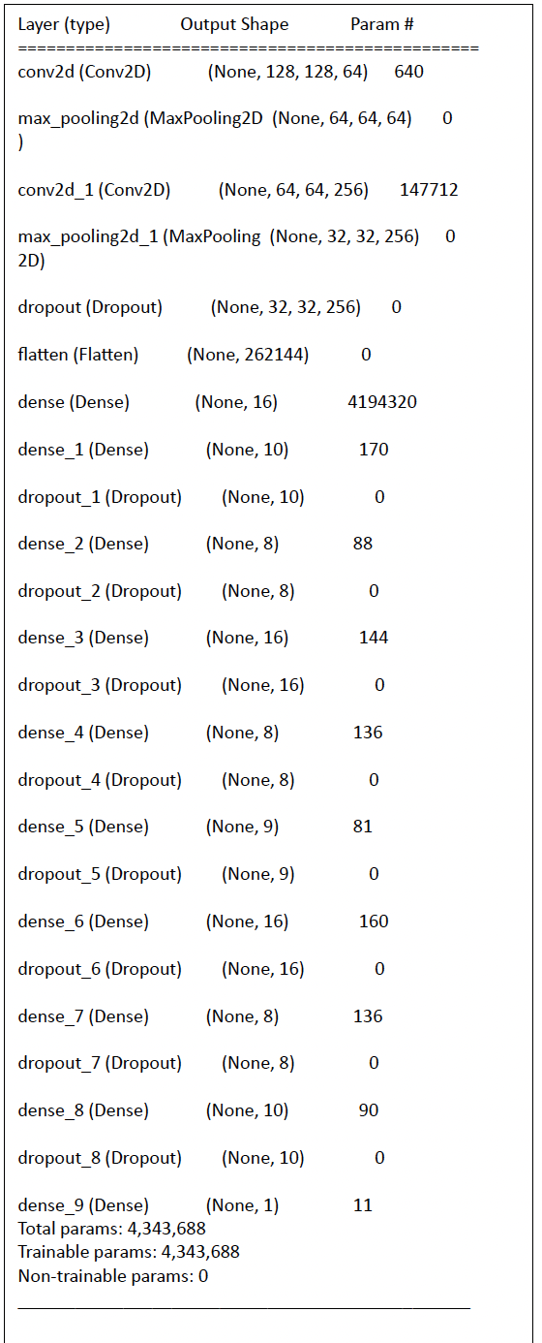
CNN MODEL SUMMARY BEFORE AND AFTER hYPER-PARAMETER TUNING
Fig. 15 Before Tuning
Fig. 16 After Tuning
Notes:
Here we have used the optimizer and activation functions to be tuned by the hyperparameter. We have added dropout layers to avoid overfitting.
It was a two layer CNN and now we have converted into 10 layer CNN. With the increase in the number of layers, the features extracted will be more specific. Each Layer in the Neural Network contains neurons, which compute the weighted average of its input and this weighted average is passed through a non-linear function, called an “activation function; the more layers better was the classification performance.

Slide 16
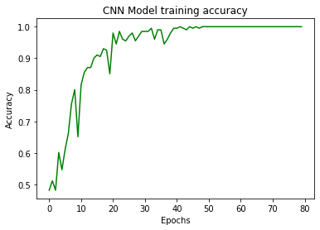
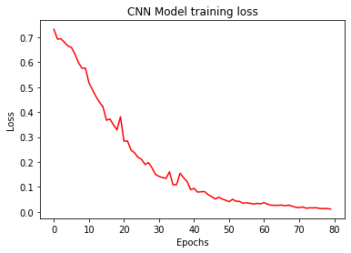
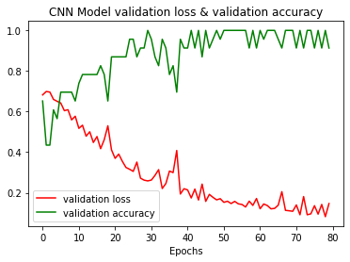
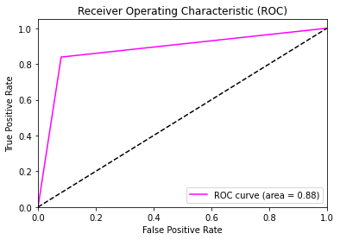
Results & observations
Fig. 17 Training Accuracy vs Epochs
Fig. 18 Training Loss vs Epochs
Fig. 19 Validation Loss and Accuracy vs Epochs
Fig. 20 ROC_Curve
Notes:
The ROC curve (Receiver Operating Characteristic curve) is a graphical representation of the performance of a binary classifier system, which measures the ability of the model to discriminate between positive and negative classes. Specifically, the ROC curve plots the true positive rate (TPR) against the false positive rate (FPR) at different threshold settings.

Slide 17
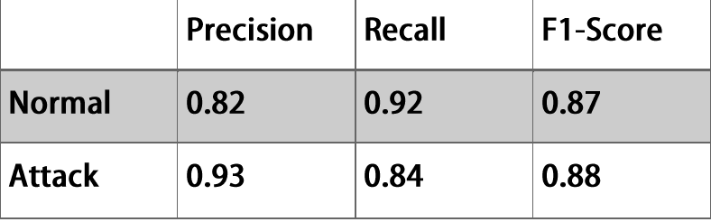
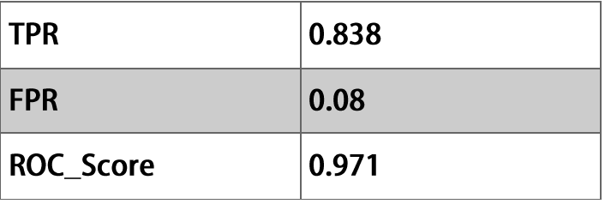
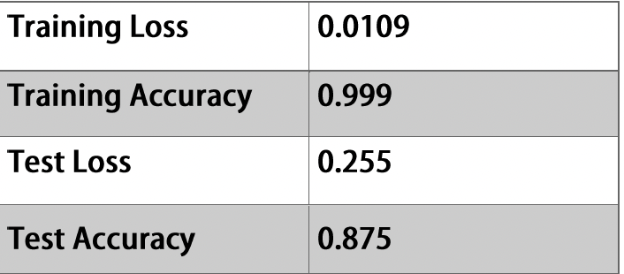
Results & observations
Fig. 21 Precision, Recall , F1 Score
Fig. 22 TPR, FPR, ROC_Score
Fig. 23 Loss and Accuracy for Training and Test Phase

Slide 18
COMPARISON OF CNN VS RNN:
We have also compared the model testing accuracy with the RNN(Recurrent Neural Network) model.
The testing accuracy was 85.71%, and the testing loss was 93.69%.
A loss function compares the targeted and predicted output values. We aim to minimize the loss.
Our CNN model outperforms the RNN model in terms of testing accuracy and testing loss, Recall-0.74, F1-Score-0.83.
Notes:
F1 SCORE : measures model accuracy by combining precision and recall score
Recall: WHAT PORTION OF ACTUAL POSITIVES WERE IDENTIFIED CORRECTLY

Slide 19
LIMITATIONS AND FUTURE WORK
The CNN model has been trained for the dataset that is obtained from a specific car. When this CNN model is tested on datasets of other cars it will generate inaccurate results because the arbitration id numbers for ECU nodes will change from vehicle to vehicle so for each car the CNN model has to be trained separately.
This model only classifies the test data as either a benign or attack scenario, it does not provide any detail on which type of attack it is such as fuzzing, flooding, spoofing etc.
One can develop a dataset that contains various other type of attack scenarios such as spoofing RPM attacks, Gear change attacks etc. and train the IDS using these data and make the model more robust to variety of attacks.
The model can also be made to classify the attacks into their respective attacks type that is we can change the classification problem from binary classification to multi class classification problem.
Notes:
The lowest error rate is computed on validation data.

Slide 20
Using dynamic arbitration many attacks can be prevented and with an strong IDS system CAN Bus can be protected from any sort of abnormal behaviour.
THANK YOU

